Slide 1
A CUDA Implementation of Vertex Betweenness Centrality
Gavin Gresham

Slide 2
Current Implementation
Core algorithm proposed by Ulrik Brandes
A Faster Algorithm for Betweenness Centrality
Outer loop parallelized at the expense of memory
Notes:
O(n + m) memory per vertex
Crashes above 4k verts
8k requests ~18gb of memory

Slide 3
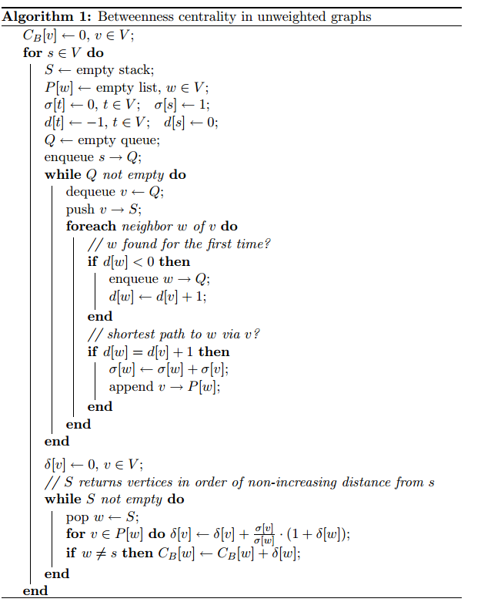
Current Implementation
Notes:
One thread per vertex loop
Unweighted = BFS

Slide 4
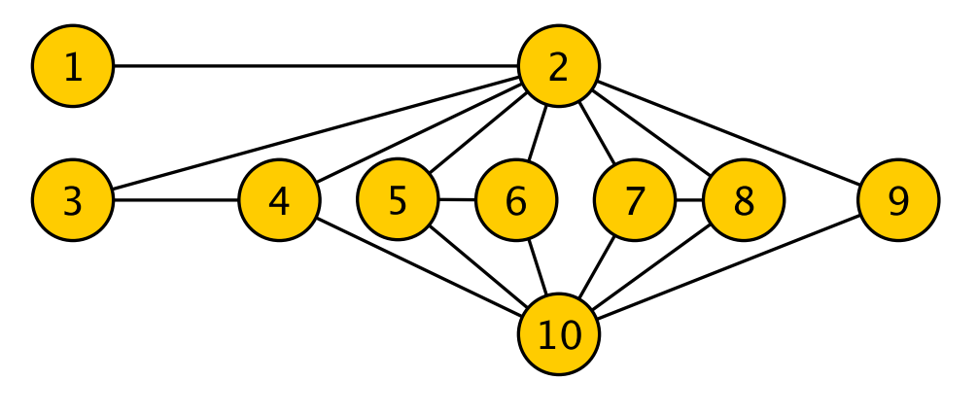
Example Graph
Courtesy Sariyuce et al
Notes:
Toy graph from paper (Ohio State University) Betweenness Centrality on GPUs and Heterogeneous
Architectures

Slide 5


Initial Implementation
…
Memory bound
Low occupancy on CUDA platforms
Start
Frontier
Notes:
One thread per vertex
Must hold memory for path counts, frontier queue, and stack
Share edges and BC sums
http://docs.nvidia.com/cuda/parallel-thread-execution/graphics/memory-hierarchy.png

Slide 6
Revised Implementation
Build upon basic implementation
Many threads per vertex
Parallel BFS
Keeps track of the current and next frontier
Notes:
One block per vertex loop
Up to 256 threads per BFS cycle
Frontier unknown. Efficiency depends
Frontier tracked so current front is done before the next one
Unweighted = BFS

Slide 7
Revised Implementation
BFS
Notes:
One block per vertex loop
Up to 256 threads per BFS cycle
Unweighted = BFS

Slide 8

Vertex Level Parallelization
…
Increased occupancy of CUDA threads
Doesn’t increase the memory requirements
Increased complexity
Atomic operations required for shared arrays
Start
Frontier
Notes:
One block per vertex
Doesn’t work yet…
http://docs.nvidia.com/cuda/parallel-thread-execution/graphics/memory-hierarchy.png

Slide 9
Current Results
Vertex parallelism
Low thread occupancy
BFS parallelism
High warp divergence
Notes:
Exponentially longer…

Slide 10
Challenges
Uncoalesced memory access
cudaMalloc() is the majority of running time
CUDA warp divergence
Efficient use of shared memory

Slide 11
Memory Access
Global memory read in 32B lines
Can be shared within a warp (32 threads)
128B line for cached
Sequential reads not required, just aligned
*Compute Capability 2.0 and greater*
Notes:
Global: 8 ints in one read if aligned
Cached: 32 ints
Non-sequential would have been 8x reads per line in CC 1x
Aligned means within cache line 0-31, 32-63, etc.
BFS rarely has these occuring with the memory structures I use
Distance array and pathcount array are called 100,000s of times in 256 node array. Almost entirely unaligned

Slide 12
CUDA Divergence
i1
i1
i1
i1
int idx = threadIdx.x +
threadIdx.y * blockDim.x
switch(idx):
case 0: …
case 1: …
case 2: …
case 3: …
i2
i2
i2
i2
i3
i3
i3
i3
i4
i4
i4
i4
Notes:
Warps execute instructions simultaneously unless there’s divergence
X branches = X instructions done sequentially
Single Instruction Multiple Data

Slide 13
Possible Improvements
Find a good use for shared memory
Fast, but too small to hold a list of vertices or edges
Switch edge indexing
Coordinate List to Compressed sparse row
Pre-analysis of graph to optimize storage array
Would require more research
Notes:
Shmem is 48k per block on the Jinx cards
CSR based on results from “Betweenness Centrality on GPUs and Heterogeneous
Architectures”:
http://bmi.osu.edu/hpc/papers/Sariyuce13-GPGPU.pdf

Slide 14
Questions?

